Slide 1
Compact Force Sensor for Paddling Sports
Making analyzing performance More Easily accessible
Ryan Chiang
Update 4/17/2017

Slide 2
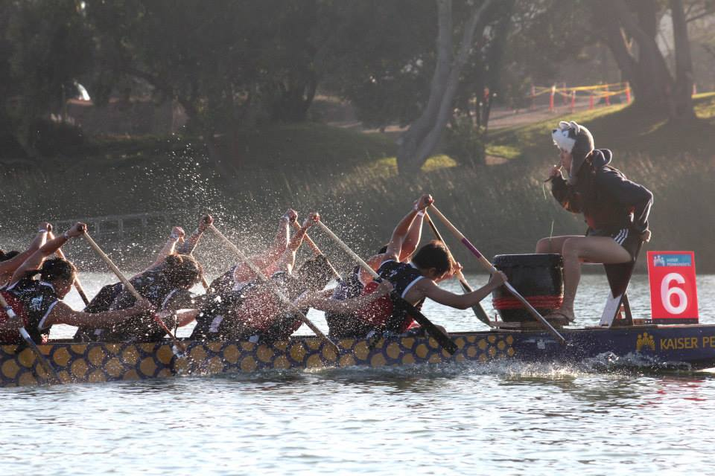
Background
Education/Technical
Paddle Sports
M.S. Electronic Circuits and Systems (UCSD)
B.S. Electrical Engineering (UC Davis)
Project Experience: Circuit Prototyping, PCB Design, Microcontroller Programming, FPGA, CAD tools
Dragonboat (8 years)
Paddling and Coaching
Kayak/Stand-up/Outrigger Canoe

